Slide 1
Project Title -
A Deep Learning Approach To Detect Drivers Drowsiness.

Slide 2
Introduction
Drowsiness is one of the major cause for the accidents.
Each year, the National Highway Traffic Safety Administration(NHTSA) estimates that 100,000 police-reported accidents are the result of drowsiness.
The aim of this project is to develop a drowsiness detection system and reduce the number of drowsiness related accidents.
The majority of accidents happen due to the drowsiness of the driver. So, to prevent these accidents we will build a system using Python, OpenCV, and Keras which will alert the driver when he feels sleepy.
With this project, we will be making a drowsiness detection system.
The objective of this project is to build a drowsiness detection system that will detect that a person’s eyes are closed for a few seconds. This system will alert the driver when drowsiness is detected.

Slide 3
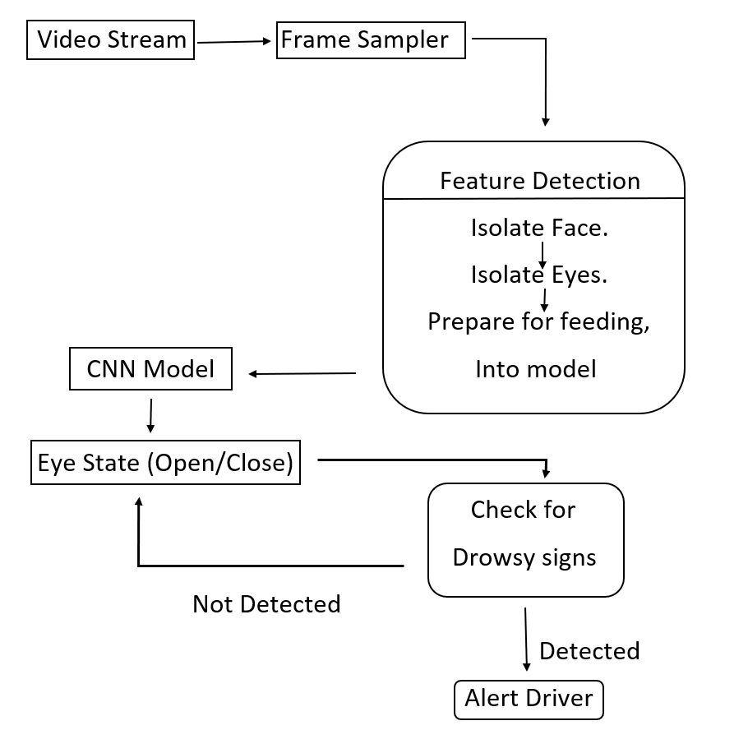
Project Overview

Slide 4
Data Identification & Preparation
This project is based on the MRL Eye Dataset. The dataset consists of 84,898 eye images of 37 subjects (33 men and 4 women). Images were taken in different lightning and reflective conditions.
The detection of eyes and eye-blinking frequency are important tasks in computer vision. The MRL eye dataset, the large-scale dataset of human eye images. The dataset is suitable for testing several features or trainable classifiers. In order to simplify the comparison of algorithms, the images are divided into several categories, which also makes them suitable for training and testing classifiers.

Slide 5
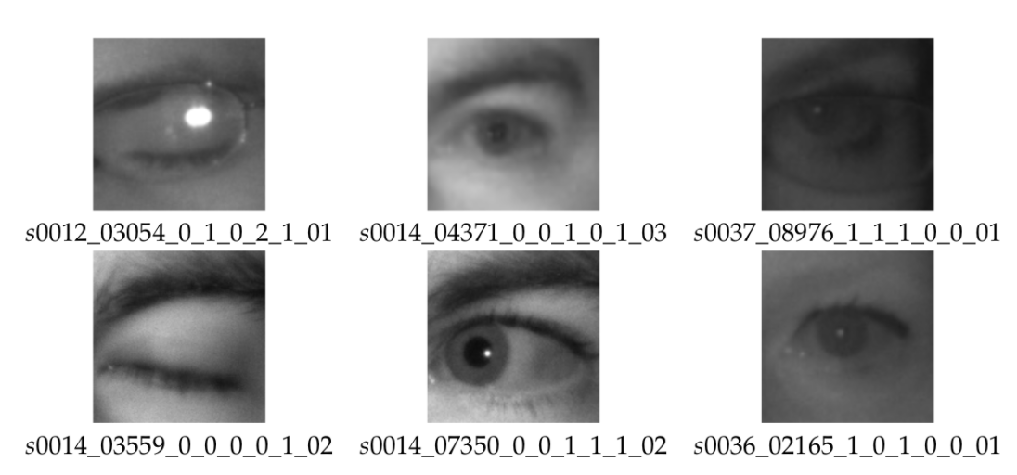
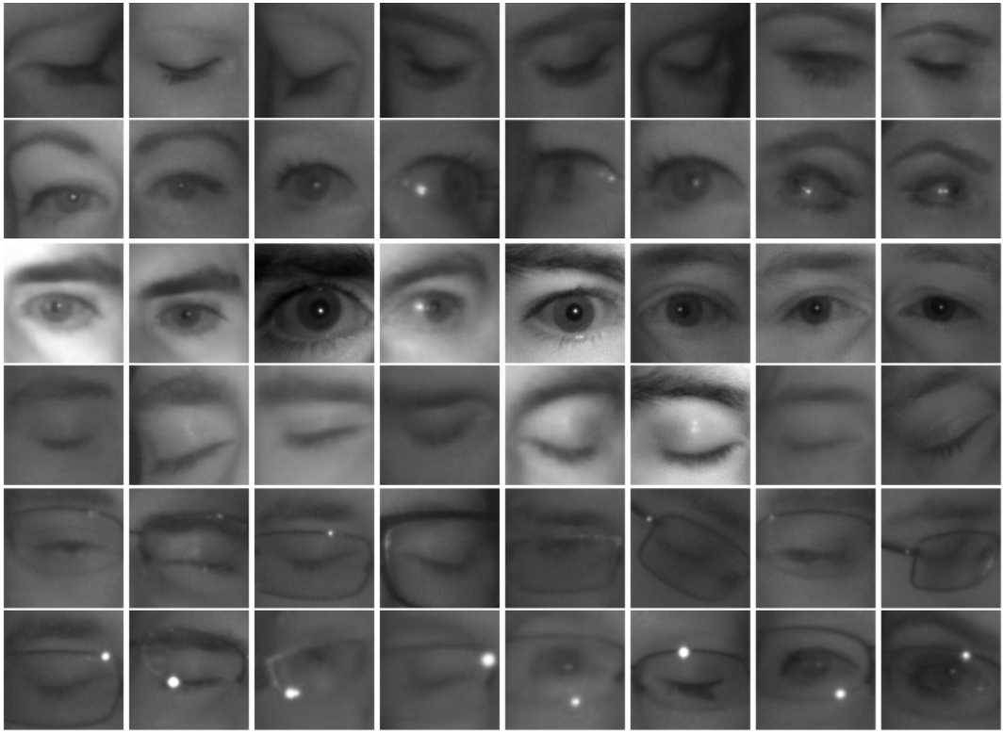
subject ID- in the dataset, we collected the data of 37 different persons (33 men and 4 women) subject ID; in the dataset, we collected the data of 37 different persons (33 men and 4 women)
image ID- the dataset consists of 84,898 images
gender [0 - man, 1 - woman]- the dataset contains the information about gender for each image (man, woman)
glasses [0 - no, 1 - yes]- the information if the eye image contains glasses is also provided for each image (with and without the glasses)
eye state [0 - closed, 1 - open]- this property contains the information about two eye states (open, close)
reflections [0 - none, 1 - small, 2 - big]- we annotated three reflection states based on the size of reflections (none, small, and big reflections)
lighting conditions [0 - bad, 1 - good]- each image has two states (bad, good) based on the amount of light during capturing the videos

Slide 6
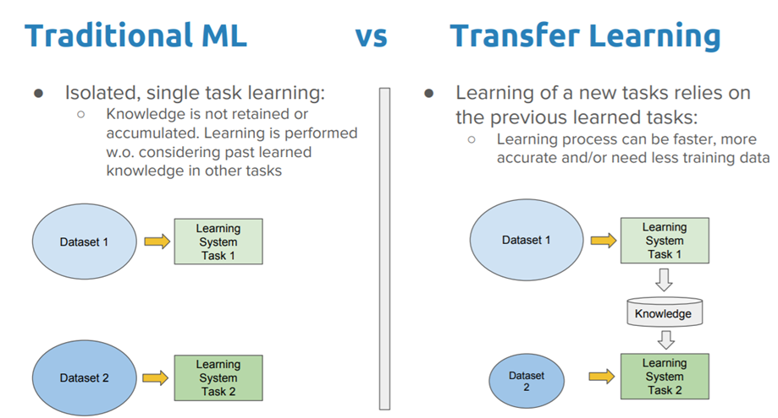
Transfer Learning
Andrew Ng – Transfer learning will be the next driver of ML success.
Transfer learning is a machine learning technique in which a network that has been trained to perform a specific task is being reused for another similar task.
Knowledge of an already trained machine learning model is applied to a different but related problem.

Slide 7
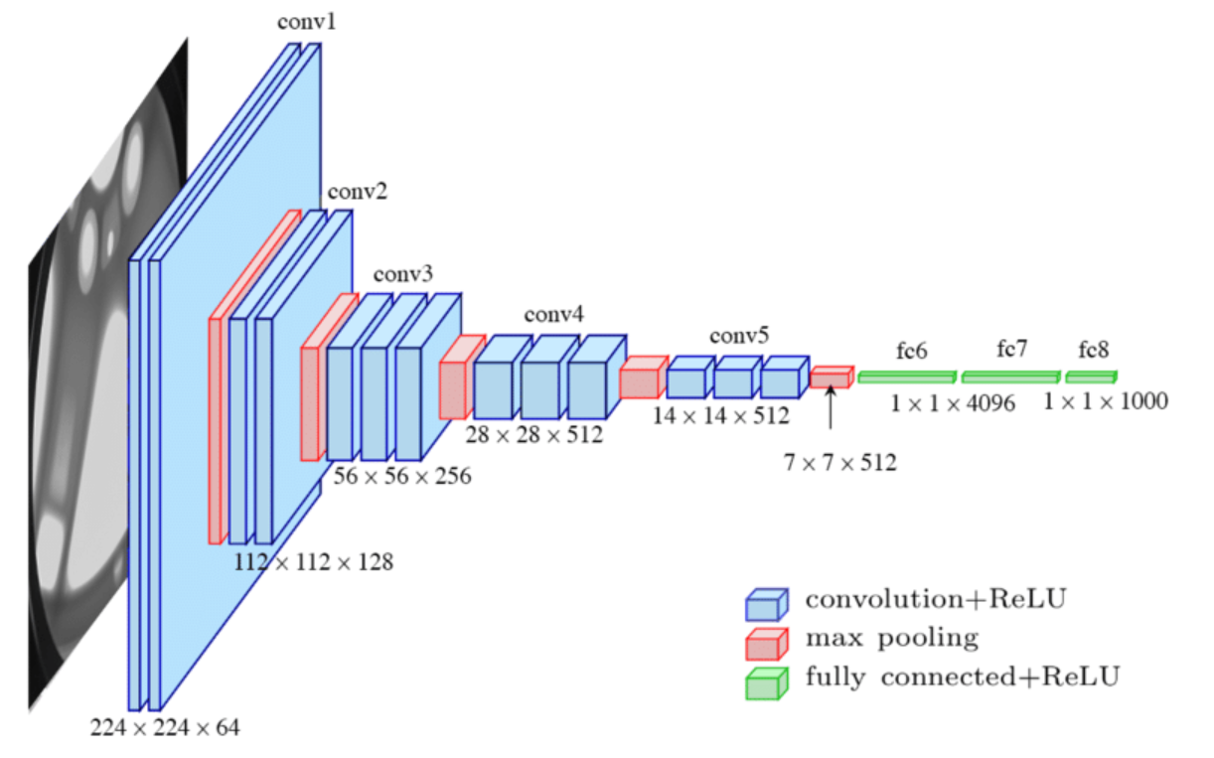
Model Training- VGG16
This is the one of the most preferred CNN architecture.
This has a 16 layers
VGG16 is preferred as it has a very uniform architecture.
Initially, it may took tougher but it is not.
It has 138 millions parameters which is certainly difficult to handle.

Slide 8
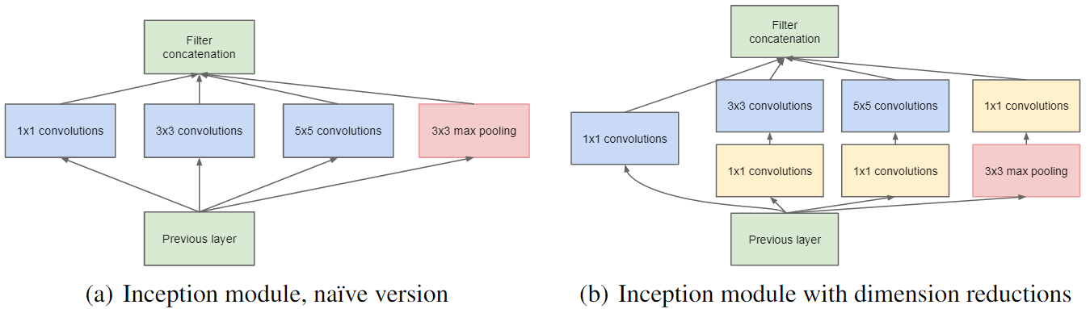
Model Training- Inception_V3
Figure (a) shows the logic behind Inception.
Figure (b) shows the Dimension reduction which is Inception_V1.

Slide 9
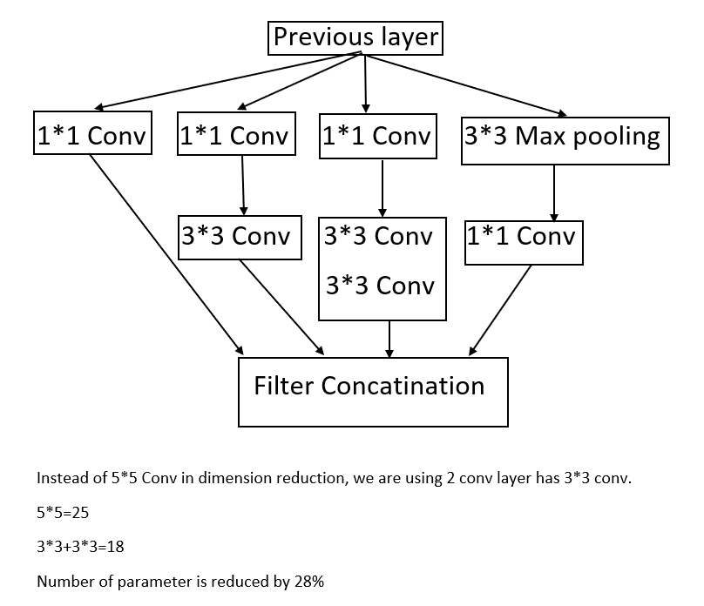
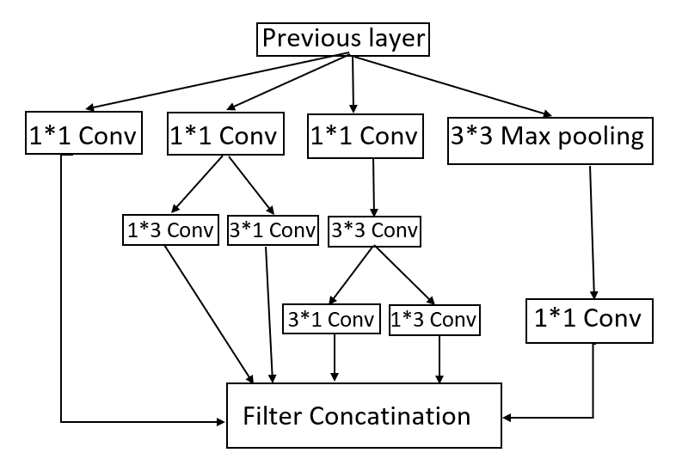
Factorization into smaller convolutions. Inception Block A
Inception Block C

Slide 10
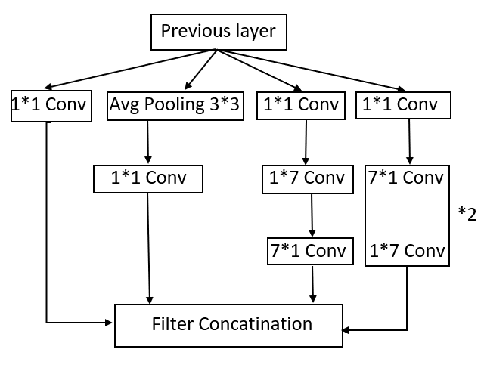
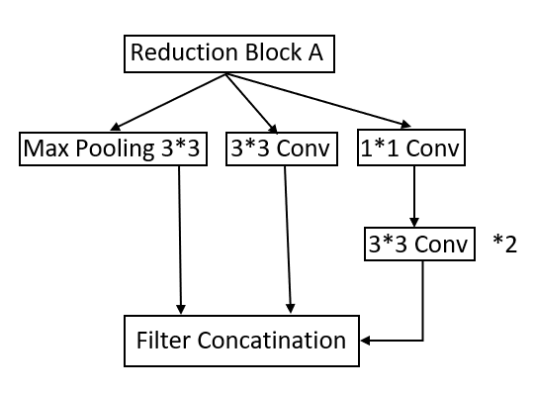
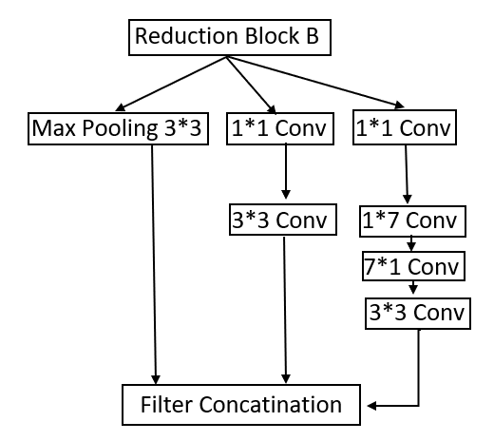
Factorized 7*7 Convolutions. Inception Block B
Reduction Block A

Slide 11
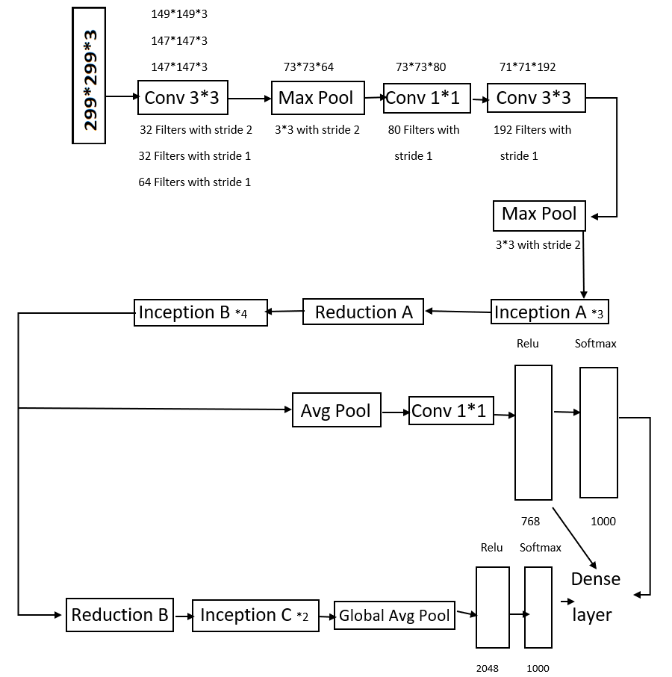
Figure show the Inception_V3
This is 48 layer network
Trained on image net dataset for 1000 classes

Slide 12
Results
Model | Train Accuracy | Test Accuracy
VGG16 | 0.9095 | 0.7872
Inception_V3 | 0.8220 | 0.6288

Slide 13
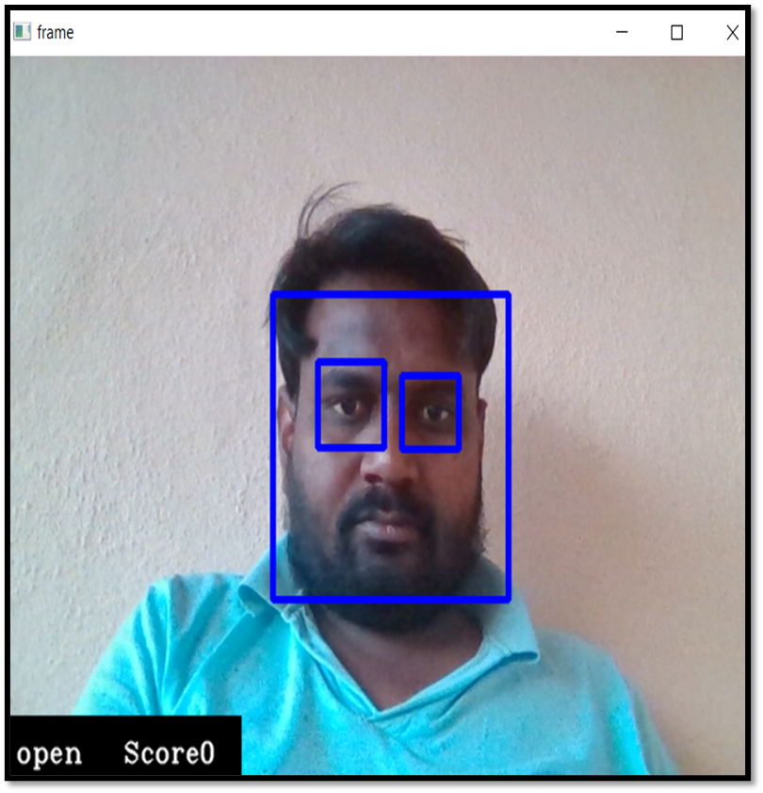
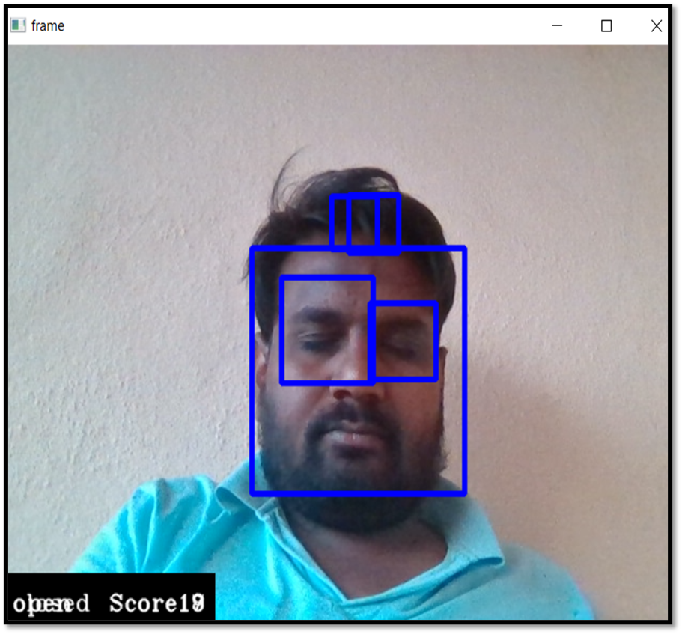
Haar Cascading
Voila-Jones face detection technique popularly known as Haar Cascades.
Haar Cascading is excellent to build a powerful models that can build with the modern day deep learning techniques.
Its fast and Pretty accurate.
It is used to identify faces and eyes in image or a real time video.
I checked it on my friend and I got positive results.

Slide 14


